Slide 1


UKIEPC 2024
Summary and solution outlines

Slide 2
Problem Solutions

Slide 3
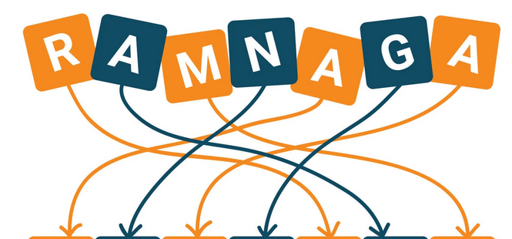
Amalgram
Overview
Create a word containing:
All of the letters of word1
All of the letters of word2
If a letter occurs:
N times in word1
M times in word2
Then it should occur at least max(N,M) times in word3
?? correct • solved at: ??:?? by
??
??

Slide 4
Amalgram
Techniques
Algorithm
Hashmaps
Sorting
We need a way to take the superset of both strings
One method inspired by merge-sort:
Sort both of the strings
Create two pointers i,j. For as long as i<n, j<m:
If a[i] == b[j]: Print a[i] and advance both i++, j++
Otherwise if a[i] < b[j]: Print a[i] and advance i++
Otherwise: print b[j] and advance j++
Other methods exist
Like counting frequency in a hashmap for each string

Slide 5

Budget Analysis
Overview
You are given a formula for linear regression and must optimise the parameters to the formula
The optimisation takes place on many different subarrays of the same list
Invent a way to do this efficiently (faster than O(N) in the size of the list)
0 correct • solved at: ??:?? by
??
??

Slide 6
Budget Analysis
Techniques
Algorithm
Calculus
Prefix sums
Taking the partial derivatives and solve the resulting linear equations system.
One could see that for the linear regression of y on x (even if it is regularized) one needs to know the following:
sum(x_i), sum(y_i), sum(x_i^2) and sum(x_i * y_i).
Given that the given x_i and y_i are constant, we could precompute the prefix sums and get the regression coefficients for each query in O(1). Computing the prediction also takes constant time.
Overall time complexity of the solution is O(n+m)

Slide 7
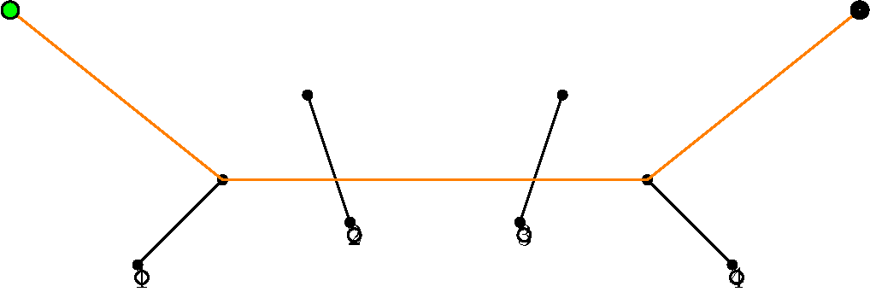
Cross Country
Overview
Draw the shortest line going through some line segments A, B, C, D, … Z
Going through a line segment multiple times is OK, but you must go through the segment in the right order too.
0 correct • solved at: ??:?? by
??
??

Slide 8
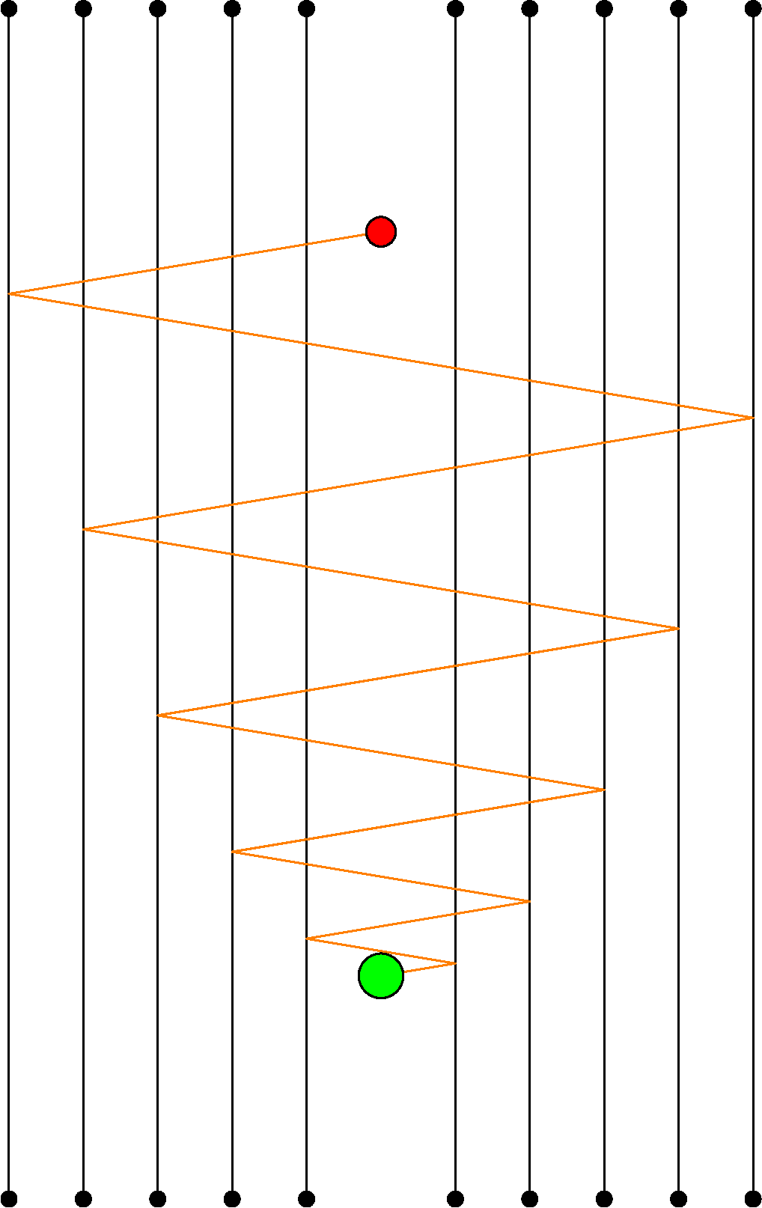
Cross Country
Techniques
Algorithm
Geometry
Dynamic programming
When we encounter a line segment on our path, there are three potentially-optimal moves:
Keep going in the same direction
Keep going in a reflection of the same direction
Completely change direction
The shortest path will only completely change direction if it touches the endpoint of a line
Otherwise the path could be shortened by changing angles
Eliminate the reflection aspect by generating 2^N scenarios of “virtual line segments” where reflection is already simulated.
Then it’s a shortest path problem:
Two segment endpoints have a connecting edge iff the line between them goes through all intermediate segments.

Slide 9
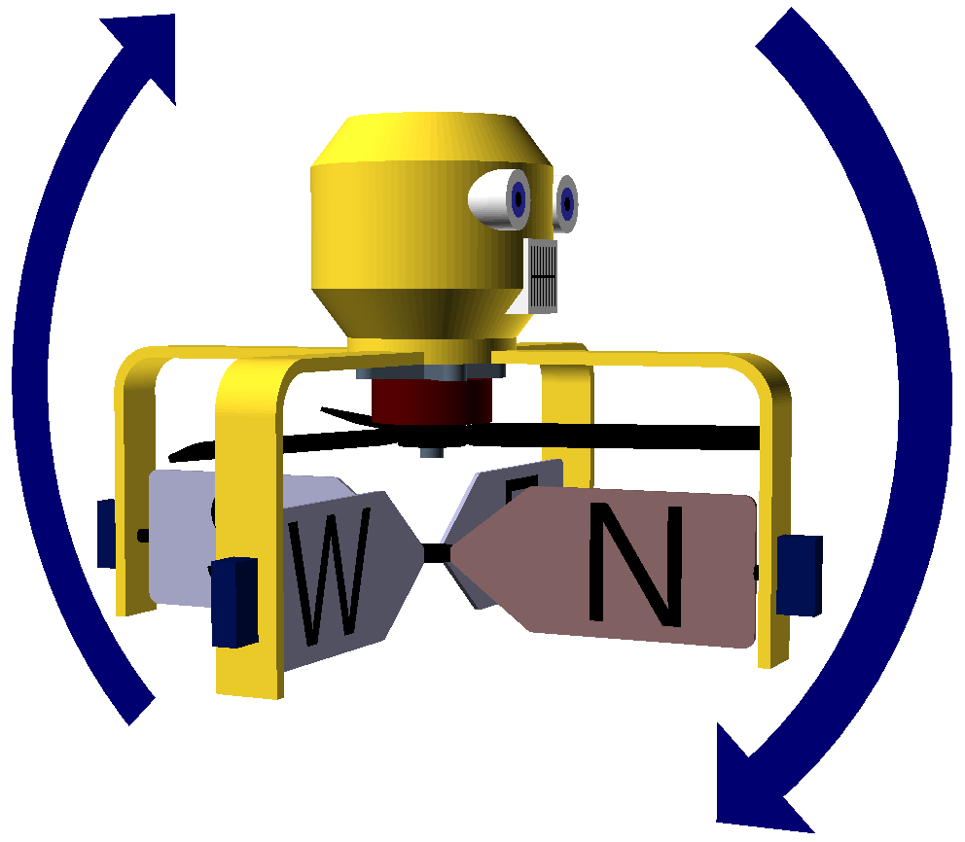
Drone Operator
Overview
Given is a system of 3 equations in 4 variables “n”, “e”, “s”, “w”
This system is underspecified, but relates all of the variables to each other.
The objective is to make the maximum of |n|, |e|, |s|, |w| as small as possible under the constraints.
0 correct • solved at: ??:?? by
??
??

Slide 10
Drone Operator
Techniques
Algorithm
Greedy algorithms
Sorting
Our equations have one spare degree of freedom:
p = e - w ::: w = e - p
r = n - s ::: s = n - r
y = n + e + s + w ::: y = 2n + 2e - r - p
In a solution where max(|n|,|e|,|s|,|w|)=T, two variables have |v|=T.
Otherwise, max(|v|) could be decreased without increasing T.
The options are: (|n|=|e|, |n|=|s|, |n|=|w|, |e|=|s|, |e|=|w|)
So either 1. Add each possibl equation into the system and solve algebraically, taking the minimum solution as the answer.
Or 2. Binary search on the value of T, and for every pair in (n,e,s,w) set both elements to T then check if this gives a valid set of equations.

Slide 11

Eradication Sort
Overview
Remove some items from an unsorted list, to make it sorted
For each gap of width W you leave in the resulting list, you pay a cost of W²
What is the minimum total cost you can achieve?
0 correct • solved at: ??:?? by
??
??

Slide 12
Eradication Sort
Techniques
Algorithm
Dynamic programming
Binary indexed trees
Convex line functions
Straightforward dynamic programming gives a (too slow) solution:
cost[x] = the cost in case the last item kept so far is y[x]
cost[x] = min(cost[i] + (x-i)² for-all [i < x] st. y[i] ≤ y[x])
Complexity of implementation is O(N²)
We need ways to find the candidate values, and to get the minimum among them, quickly.
cost[x] = cost[i]+(x-i)² can be rearranged as a line equation:
cost[x]-x² = cost[i]+i² - (2i)x
If we ignore (y[i] ≤ y[x]), we can store the lines in a list sorted by gradient, and use binary/two-pointers search to find the best line for a given x.
To address the (y[i] ≤ y[x]) constraint, we’ll create a binary-indexed tree of these lists. After calculating cost[x], update lines[y[x]...inf].

Slide 13
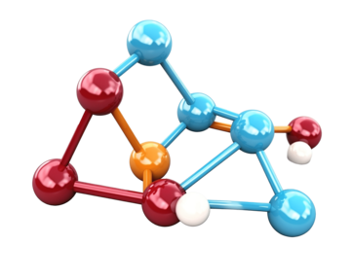
Finding Proteins
Overview
The coordinates of some points with high dimensionality are given
We will build a subset of these points and call it K.
K is built by repeatedly taking the point which is farthest from the closest point in K
Find a way to build the set K quickly.
0 correct • solved at: ??:?? by
??
??

Slide 14
Finding Suspicious Proteins
Techniques
Algorithm
Ad-hoc optimisation
Precalculation
When choosing the next value V (which happens K times):
We need to calculate min( dist(V, k[i]) forall existing k
This is (O(L*K)) ) - too slow
However, min(dist(V, k[0…i])) is the same as:
min(dist(V, k[0…i]), dist(V, k[i+1]))
The only thing that changes is the addition of the new element of K, and this can be updated later.
We can maintain the current minimum distances to so-far-unselected items as dist[0…n-1]
Every time we choose a new element of K, update all the distances with min(cur, dist(k))

Slide 15

Grid Search
Overview
You are given a 2D word and a 2D grid in which to search for that word
Highlight the places where the word occurs in the grid.
0 correct • solved at: ??:?? by
??
??

Slide 16
Grid Search
Techniques
Algorithm
Hashing
FFT
String-matching algorithms based on hashing (Rabin-Karp) and FFT translate well over to multiple dimensions
For example, using a polynomial hash we can use 2 passes:
For each row, save the running hash of the last N items
Then for each column, make a running hash of the last M hashes (using P^N or some other prime for rows)
Knowing the size of the word in advance helps with this, eg. building prefix sum tables for each row.
Standard string-matching with Aho-Corasick is adaptable enough to work too.
First, for each row find which string(s) match at each column
Then, look in each column for the right pattern of match IDs
Both steps are one-dimensional string matching problems.

Slide 17
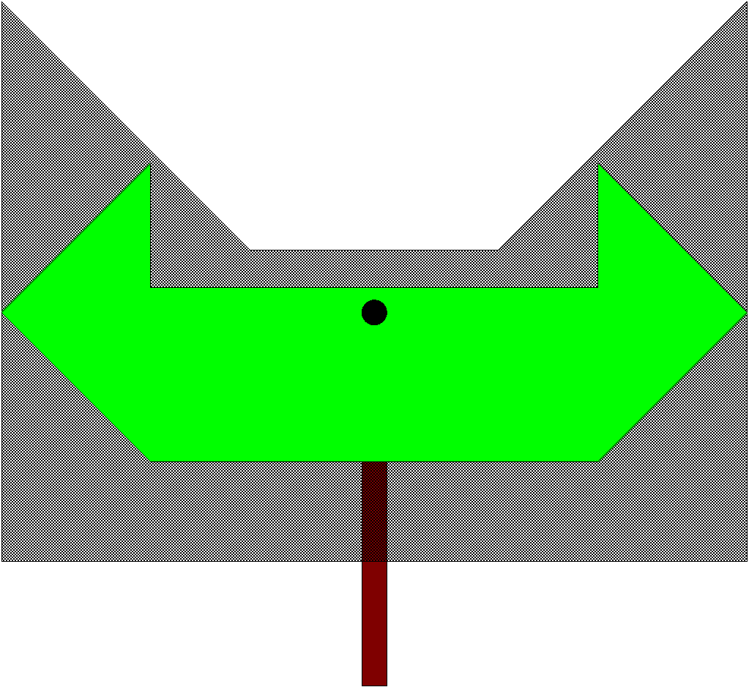
Hedge Topiary
Overview
You have two shapes, A and B.
The shapes may be convex.
However, the shapes are simple polygons with integer-aligned vertices.
Shape A needs to fit inside B.
How big can you scale A (around the origin) so that it fits inside B?
0 correct • solved at: ??:?? by
??
??

Slide 18
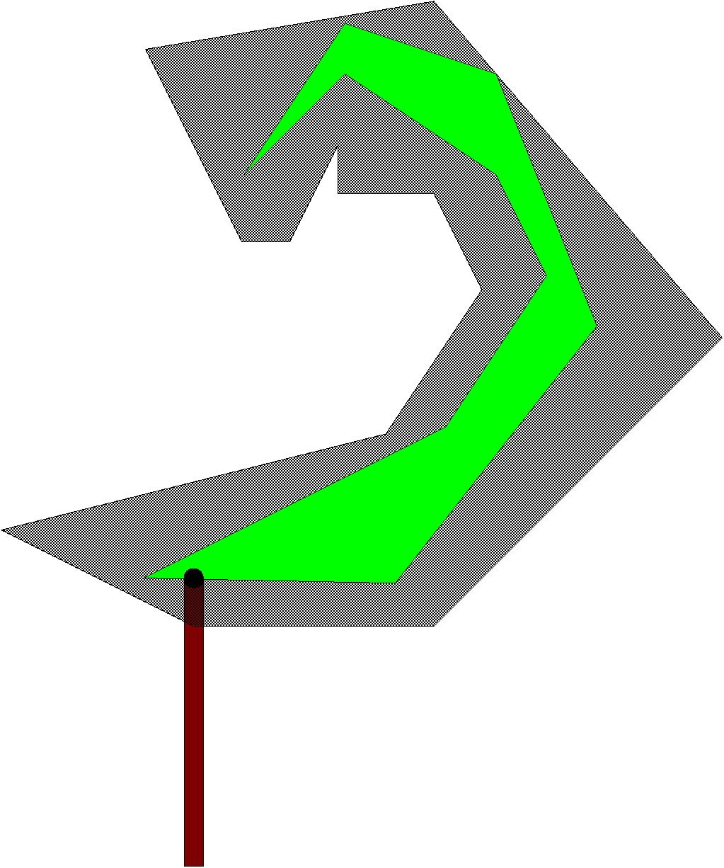
Hedge Topiary
Techniques
Algorithm
Ray-ray intersection
Sweepline
Rational arithmetic
Imagine slowly scaling shape A up. At times, the boundaries of A cross inside/outside the boundaries of B (and vice versa)
Such intersections happen at vertex/edge boundaries (a vertex of A/B touches an edge of B/A).
We’re going to solve the problem individually for a “radial slice” in the direction of each vertex of A+B and combine solutions later.
For each vertex in the input, find the one-dimensional “slices” of A and “slices” of B in the direction of that vertex.
We need to align these slices so that they overlap.
For each slice attached to a vertex, find the set of feasible ranges of scale factors where it can “fit” into/around the slices of the other shape
Finally, use a sweepline to intersect the sets of feasible regions.

Slide 19

Inconsistent
Overview
We want to demonstrate Simpson’s Paradox.
Two teams have been training equally hard across N categories of problem
Team1 solved a[i]/b[i] of category i
Team2 solved c[i]/d[i] of category i
Both teams attempted M problems in total.
Generate a table of results where team1 has done better than team2 on each individual category, but team2 has solved more tasks overall.
0 correct • not solved

Slide 20
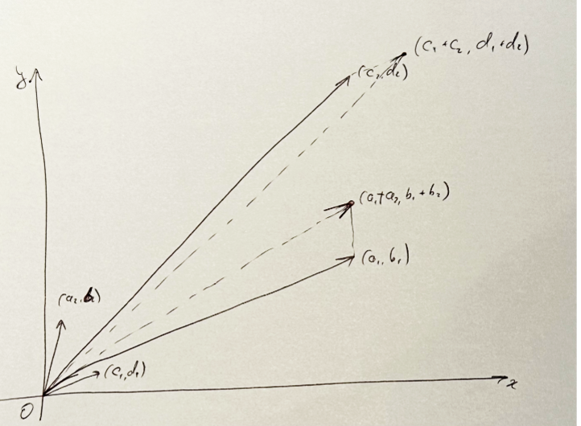
Inconsistent Patterns
Techniques
Algorithm
Construction
Given the M >= 4N one construction that works is as follows:
- (M-3*(N-1)-1) / (M-3*(N-1)) < 1/1
- 1/3 < 1/2: repeated (N-2) times
- 1/3 < x / (M-1-2*(N-2))
where x is the smallest integer such that this inequality holds, ie floor(M-1-2*(N-2))
The intuition behind this construction is looking at (a_i, b_i) and (c_i, d_i) as two-dimensional vectors.
We need pairs of vectors such that:
the slope of vector1 is greater than the slope of vector2
while this order reverses when we add up all first elements is pairs and all second
(sum(a_i) / sum(b_i) correspond to the vector sum of (a_i, b_i)).

Slide 21

Jabber Network
Overview
You start with a connected, unrooted binary tree of computers (nodes) and connections (edges)
Distances between nodes are defined using “demands”
Periodically an edge will be removed from the tree, and you need to re-connect the graph in the cheapest way possible according to demands x distance.
0 correct • solved at: 02:53 by
??
??

Slide 22
Jabber Network
Techniques
Algorithm
DFS on trees
Precomputation
Once an old link is removed, the graph is split into two connected components, and you need to reconnect them again.
You can search for the endpoints of a new edge independently in each of these 2 components
…

Slide 23
Jabber Network
Techniques
Algorithm
DFS on trees
Precomputation
Our way of searching for an endpoint in a component:
Identify all demands (s_i, t_i, d_i) that leave that component
(s_i being a vertex in the current component)
The contribution of the endpoint p is the sum of products of demand d_i times the distance between s_i to p
This contribution can be recomputed efficiently when you move p to one of its neighbours
to do that, precompute sums of demand products in each subtree using a DFS
This makes it possible to find the best endpoint using another DFS
Complexity: O(n(n + d)): n iterations, each iteration takes O(n + d)

Slide 24

Knitting
Overview
Complete the design of a scarf made out of patchwork stripes
Within a range of K stripes, the same colour shouldn’t occur more than once
Otherwise, make sure that no colour appears too often (minimise the frequency of the most-frequent colour)
0 correct • solved at: ??:?? by
??
??

Slide 25
Knitting
Techniques
Algorithm
Greedy algorithms
Priority queues
If a scarf can be constructed, we can build it with a greedy algorithm
Go from left-to-right filling in spaces.
Scan the last K-1 items of the existing scarf, looking for colours that we can’t use for now.
Put the remaining colours in a priority queue where the least-used colour is on top (it’s always best to use this if available)
Every time we add a colour from the priority queue, remove it from the queue and add scarf[i-k+1] to the queue instead.
Make sure to check the resulting scarf is valid! (And that the priority queue never ran out of items)

Slide 26

Leg Day
Overview
Given a pattern of up to 31 strings, represent those strings using emojis and repeat those emojis up to 31 times to make a nice calendar
The emojis you pick should match the strings, eg. “todayislegday” should be represented by a “🦵”
0 correct • solved at: ??:?? by
??
??

Slide 27
Leg Day
Techniques
Algorithm
Unicode
Grit
Make sure to print the week numbers at the start of each line!
For each string, use your standard library’s string-in-string functions to check which rule it matches first (in the order specified in the input)
C++ and Python have no problem outputting UTF-8 characters in a non-UTF8 context. When printing in Java, make sure to set the encoding on Strings properly.

Slide 28

Final Standings
http://ukiepc2024.cloudcontest.org/

